Slide 1
IDENTIFICATION OF OPTIMUM DRUG COMBINATION FOR CANCER USING BOOLEAN NETWORKS
PRESENTED BY
ABHISEK KARMAKAR
ARGHA NANDAN
BISHAL SAHA

Slide 2
INTRODUCTION
Cancer – uncontrolled division of cells
Cause – faults in biological interactions
Solution – application of drugs on faults

Slide 3
PROBLEM STATEMENT
Simulation of faults in a Boolean network inferred from a GF signaling pathway
Identification of optimum drug therapy to nullify the effects of faulty conditions

Slide 4
OBJECTIVE
Convert a signaling pathway into a Boolean network using pathway logic
Identify unique input vector
Simulate single and multiple faulty conditions
Apply drug combinations on faulty networks
Prescribe optimum therapy

Slide 5
SIGNALING PATHWAYS

Slide 6
SIGNALING PATHWAYS
Consists of a group of molecules in a cell
Control cell functions, such as cell division and cell death
Each molecule receives a signal, which is transmitted to other molecules down the pathway
GF pathway contains protein-protein interactions which govern cell division

Slide 7
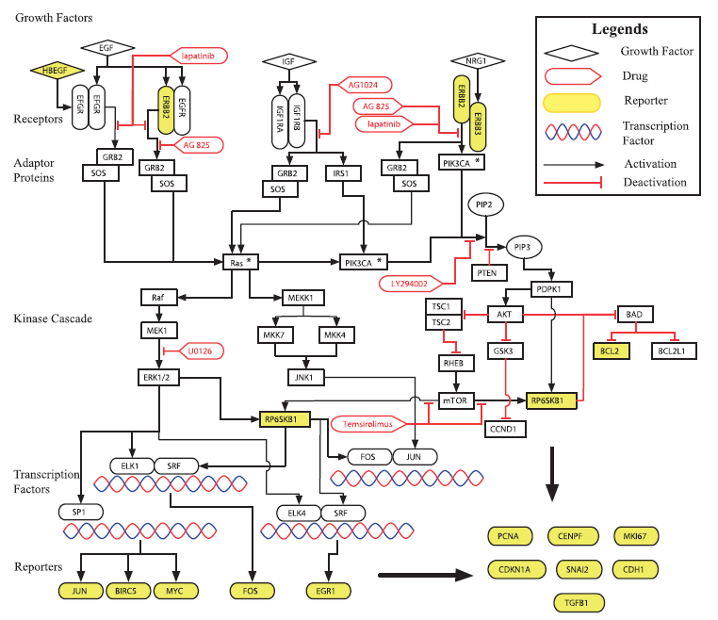
GROWTH FACTOR SIGNALING PATHWAY
(ref [1])

Slide 8
BOOLEAN NETWORKS

Slide 9
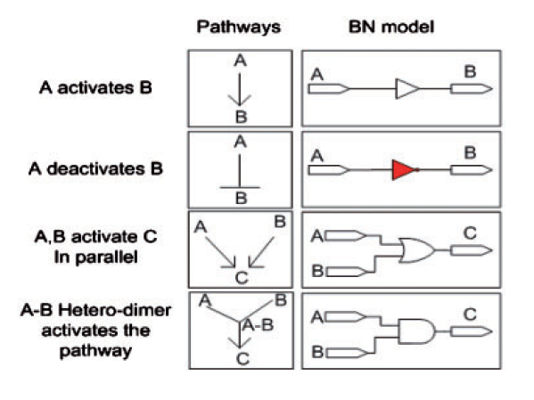
PATHWAY LOGIC
Defines the conversion of interactions in signaling pathways into their Boolean equivalents
(ref [1])

Slide 10
BOOLEAN NETWORKS
Converted from a signaling pathway
Consists of Boolean gates and nodes
Nodes represent proteins
Boolean gates represent Boolean interactions
Nodes hold values of 0 or 1
0 – inactive protein
1 – active protein

Slide 11
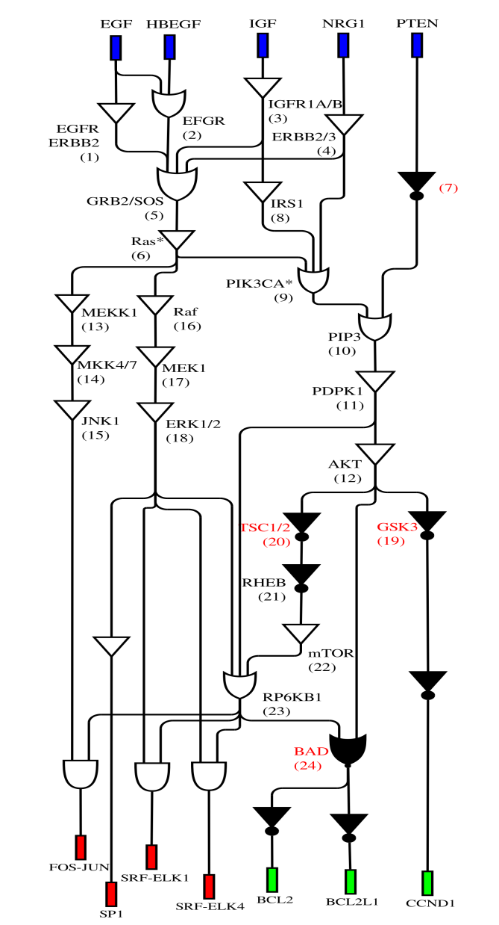
BOOLEAN NETWORK CONVERTED FROM GF SIGNALING PATHWAY

Slide 12
FAULTS AND DRUG THERAPY

Slide 13
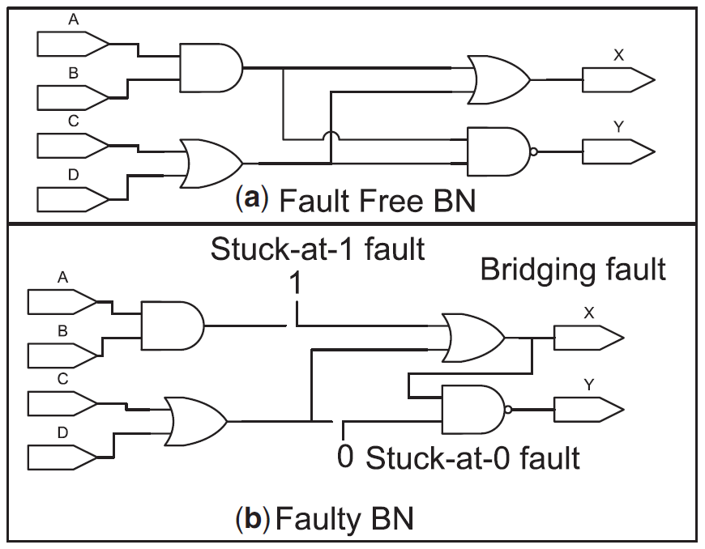
FAULTS
Malfunctions in the BN
Getting stuck to a state, or incorporation of new interactions
Faulty states reflect the states of nodes further down the network
(ref [1])

Slide 14
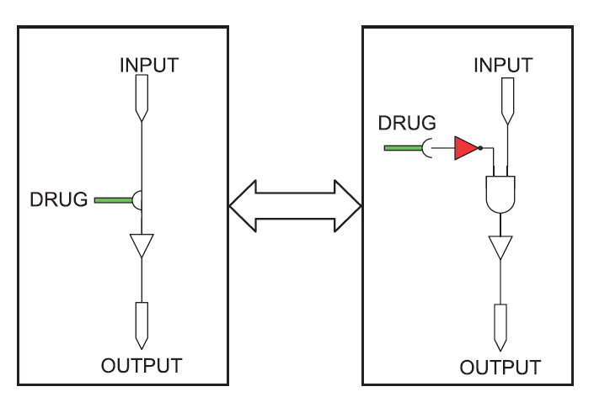
DRUG THERAPY
Drug: substance that inhibits a protein
Stuck-at-1 and stuck-at-0 nodes both are inhibited
(ref [1])

Slide 15
GPU ACCELERATION

Slide 16
GPU ACCELERATION
Multiple fault modeling takes hours
Simulating 4 fault scenario from 24 nodes takes close to 3 hours
CPU provides a few parallel threads
GPU provides hundreds of threads at once
Greatly reduces execution time
CPU provides 8 threads
GPU supports 1024 threads
Decreases execution time 2¹⁰⁻³ = 2⁷ folds

Slide 17
HOW GPU WILL WORK ALONG WITH CPU
The data from CPU is copied to GPU using cudaMemcpy(cpu_data,gpu_data,N*sizeof(type),cudaMemcpyHostToDevice)
Computation is done in the gpu when kernel function is called.
__global__ void function(parameters){ }
Kernel functions executes within the GPU only.
After computation, the result is copied back to the CPU.
cudaMemcpy(gpu_data,cpu_data,N*sizeof(type),cudaMemcpyDeviceToHost)

Slide 18
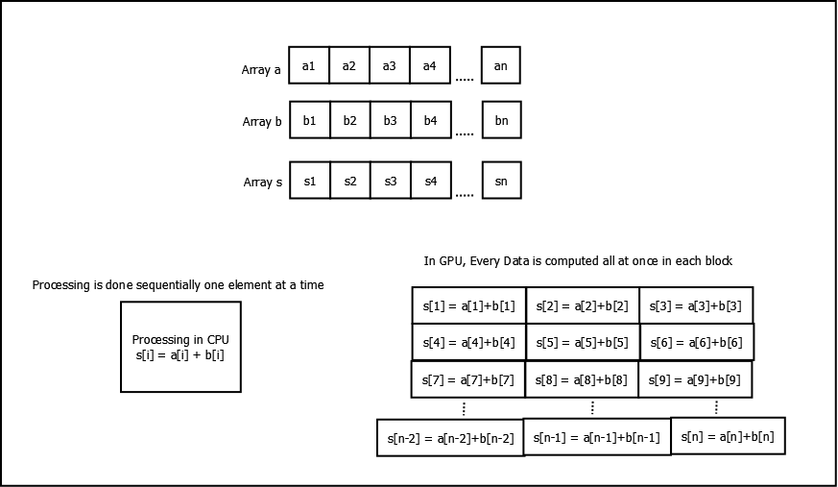
ILLUSTRATING COMPUTATION IN GPU
Calculating Sum of two Arrays and Storing into a third array parallelly in GPU.

Slide 19
1 BOOLEAN NETWORK MODELING

Slide 20
BOOLEAN NETWORK MODELING
Set of input, pathway, and output nodes as input
Model three networks:
With faults
With faults and known drug combinations
With faults and custom drug combinations

Slide 21
2 UNIQUE INPUT VECTOR IDENTIFICATION

Slide 22
UNIQUE INPUT VECTOR IDENTIFICATION
Execute fault-less Boolean network
Number of input nodes = 5
Number of input combinations = 2⁵ = 32
Identify unique input vector
Input combination which generates output that signifies non-proliferation (all bits are 0’s)

Slide 23
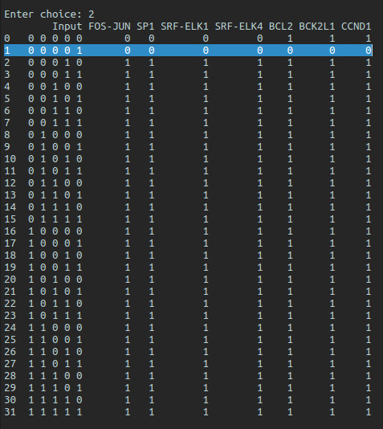
UNIQUE INPUT VECTOR
DataFrame containing input combinations and their corresponding output bits
Unique input vector, which produces output vector where all bits are 0’s

Slide 24
3 FAULT SIMULATION

Slide 25
FAULT SIMULATION
Input vector = unique input vector
Enumerate faults in the network
Single stuck-at faults
Multiple stuck-at faults
Execute Boolean networks with fault combinations and generate output vectors

Slide 26
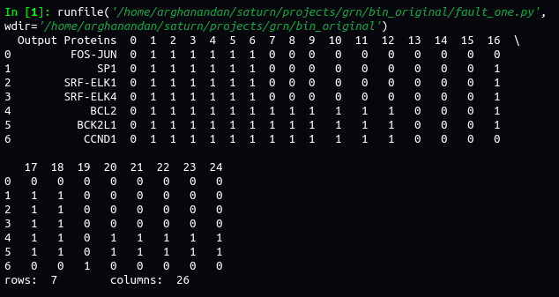
SINGLE FAULT SCENARIO
DATAFRAME CONSISTING OUTPUT VECTORS CORRESPONDING TO SINGLE FAULT LOCATIONS

Slide 27
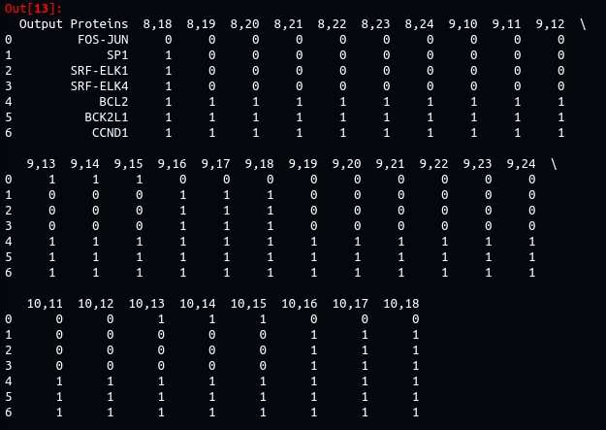
MULTIPLE FAULT SCENARIO
DATAFRAME CONSISTING OUTPUT VECTORS CORRESPONDING TO DOUBLE FAULT COMBINATIONS

Slide 28
4 DRUG APPLICATION

Slide 29
APPLICATION OF KNOWN DRUGS
Model interference points of 6 known drugs
Enumerate drug combinations 2⁶ = 64
Execute Boolean network with drug combinations with combinations of fault locations
Single faults
Multiple faults

Slide 30
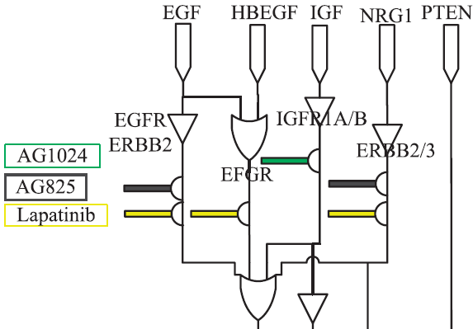
DRUGS INHIBITING PARTICULAR PROTEINS
(ref [2])

Slide 31
ENCODING
Given 7-bit output vector is converted into a single float value^{[1]}:
Output vector = [a, b, c, d, e, f, g]
x = a + b + c + d
y = e + f + g
Encoded weight = ω*(x*y) + (1 - ω)*(x + y)

Slide 32
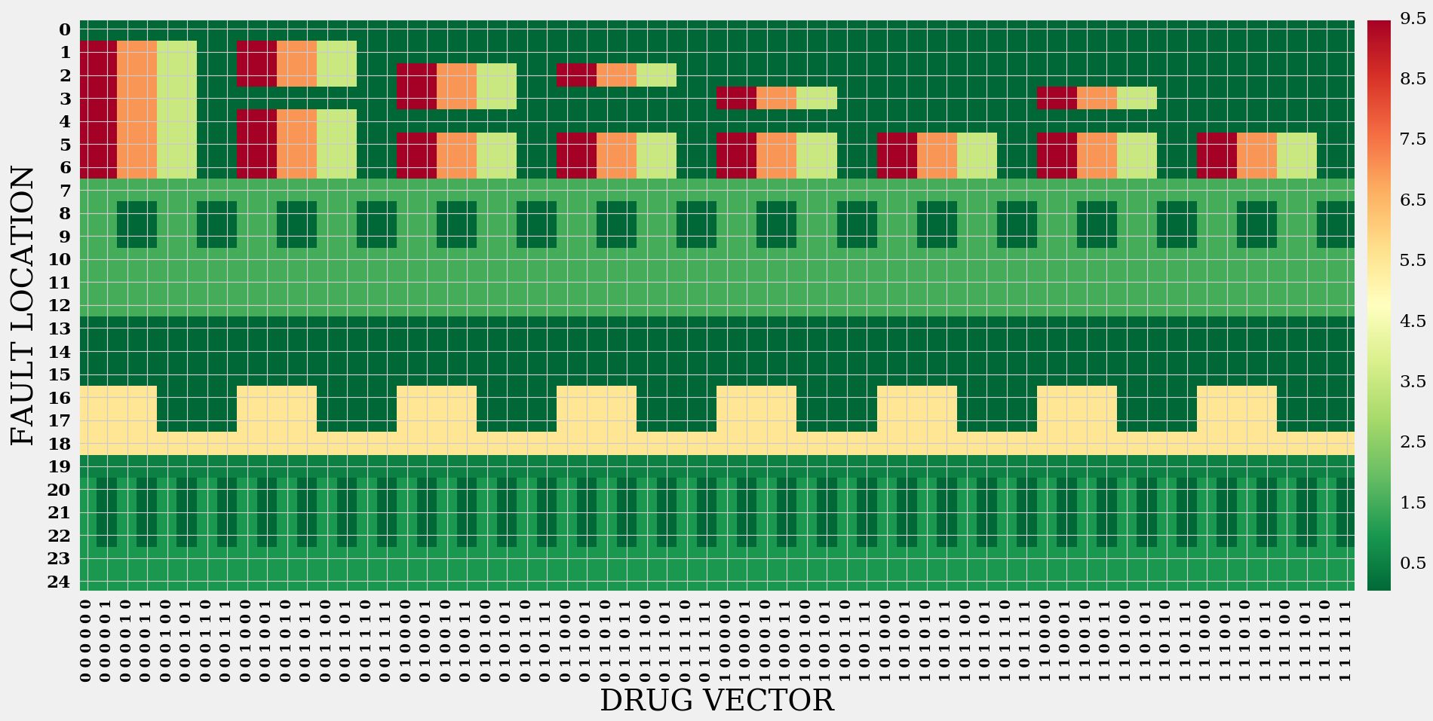
DRUG APPLICATION ON SINGLE FAULTS
DRUG VECTOR V FAULT LOCATION

Slide 33
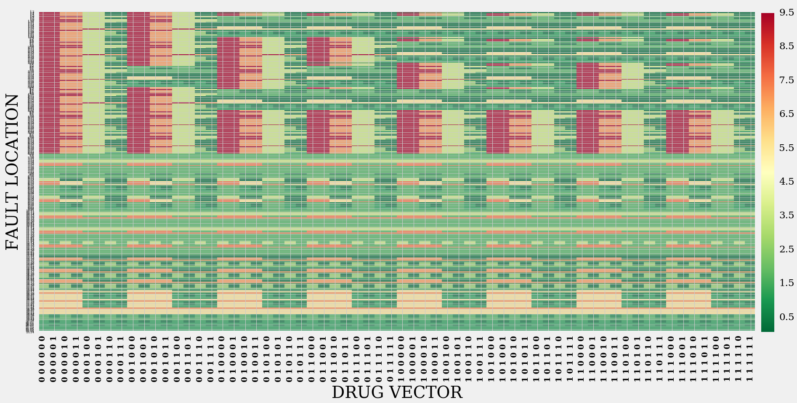
DRUG APPLICATION ON DOUBLE FAULTS
DRUG VECTOR V FAULT LOCATION

Slide 34


CONDENSING
If enc₀ is the drugless output, and faultn is the number of faulty combinations:
Calculating relative effect of each drug vector:
where cond_{i} and encv_{i} are condensed weight and encoded output corresponding to drug i

Slide 35
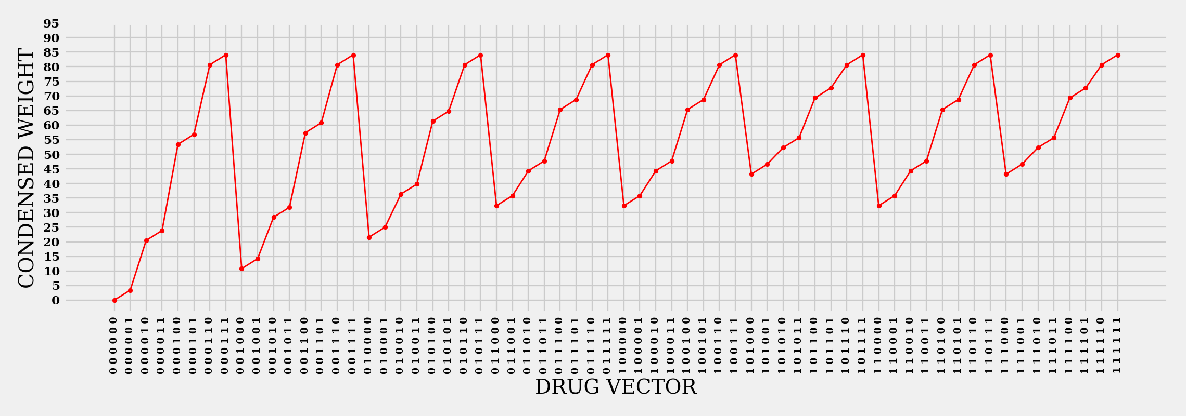
DRUG APPLICATION ON SINGLE FAULTS
DRUG VECTOR V CONDENSED WEIGHTS

Slide 36
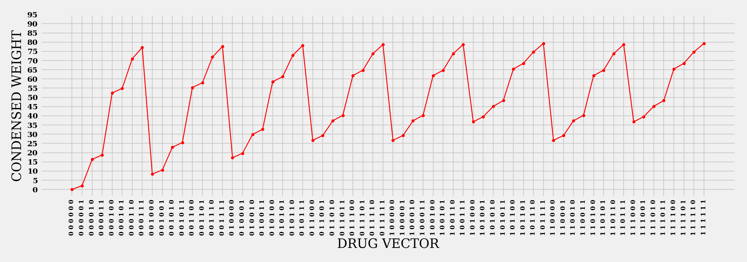
DRUG APPLICATION ON DOUBLE FAULTS
DRUG VECTOR V CONDENSED WEIGHTS

Slide 37
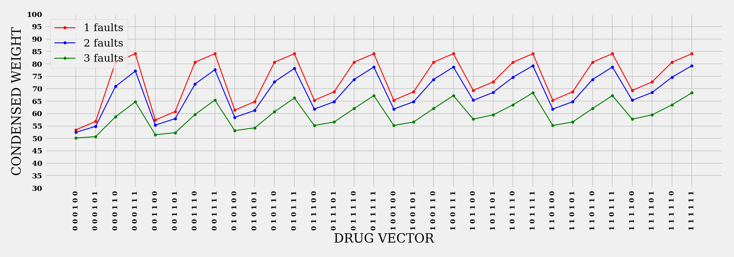
DRUG APPLICATION ON FAULT SCENARIOS 1-3
DRUG VECTOR V CONDENSED WEIGHTS

Slide 38
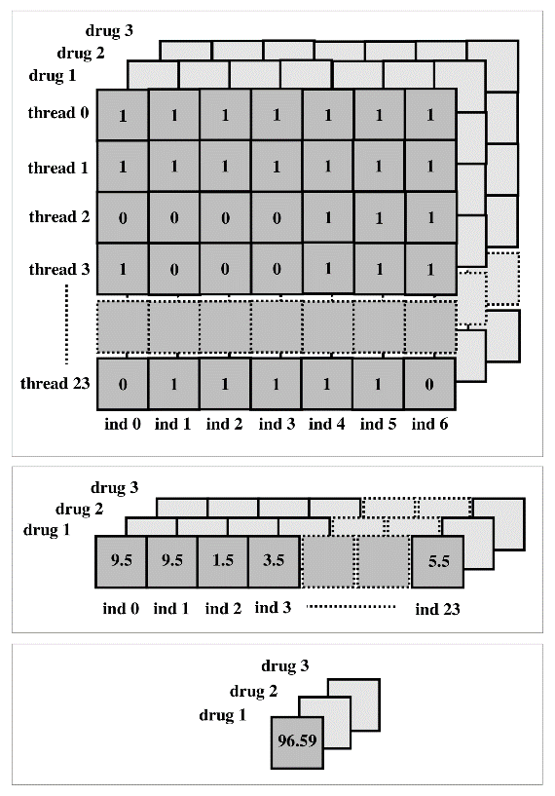
PARALLEL DRUG APPLICATION VIA GPU

Slide 39
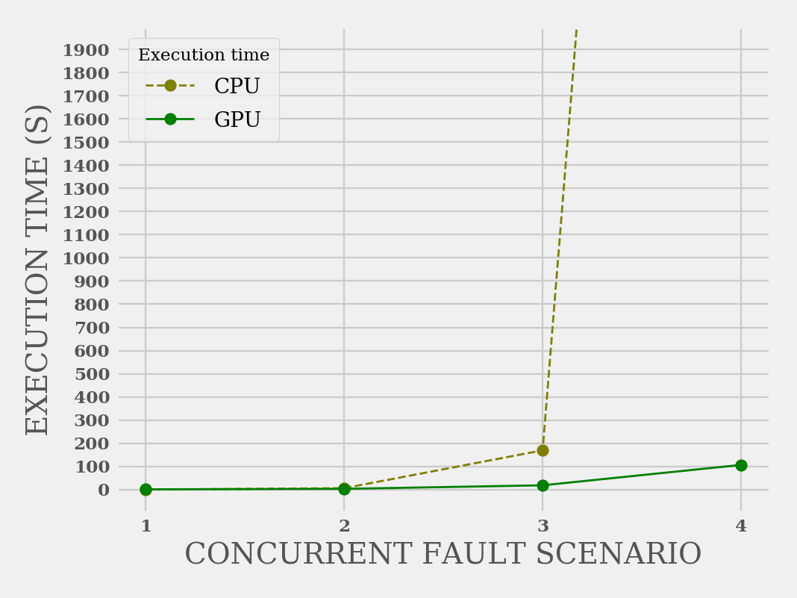
EXECUTION TIME CORRESPONDING TO SEQUENTIAL EXECUTION IN CPU AND PARALLEL EXECUTION IN GPU

Slide 40
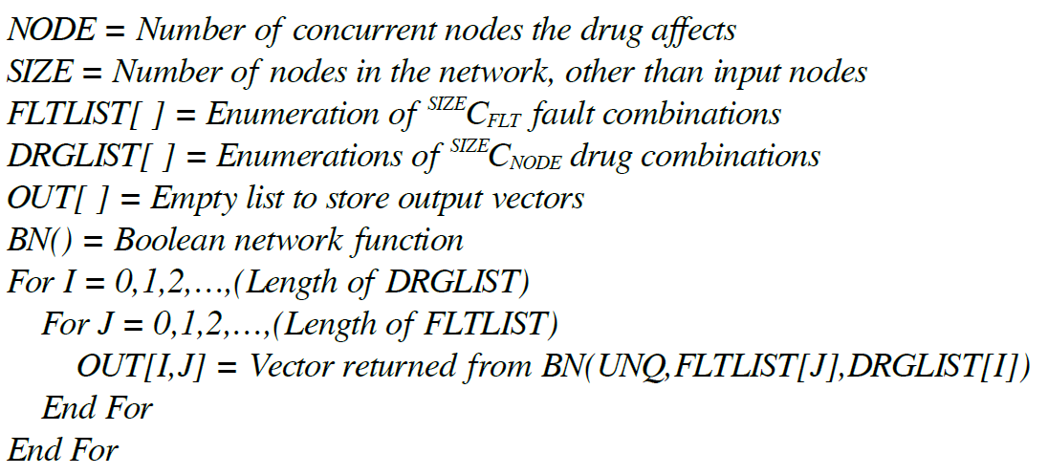
CUSTOM DRUG APPLICATION

Slide 41
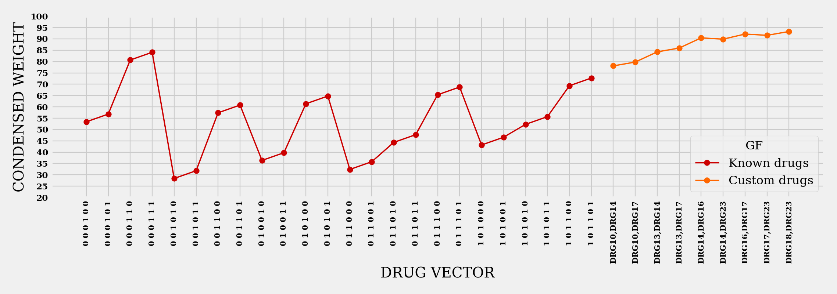
CUSTOM DRUG APPLICATION ON SINGLE FAULTS
DRUG VECTOR V CONDENSED WEIGHTS

Slide 42
CONCLUSION
Better understanding of protein behavior due to ON/OFF states in Boolean networks
Significance of proliferative and non-proliferative conditions
Realistic approach by modeling multiple faults
Faster computation of results compared to traditional sequential approach
Chances of designing drugs which affect nodes in the network generating more efficient and safer results

Slide 43
REFERENCES
Ritwik Layek, Aniruddha Datta, Michael Bittner and Edward R. Dougherty, “Cancer therapy design based on pathway logic”, Bioinformatics, Vol. 27,Advance Access 30 December 2010
Osama A. Arshad, Priyadarshini S Venkatasubramani, Aniruddha Datta, Jijayanagaram Venkatraj, “Using Boolean Logic Modeling of Gene Regulatory Networks to Exploit the Links Between Cancer and Metabolism for “Therapeutic Purposes”, IEEE Journal of Biomedical and Health Informatics, Vol. 20, No. 1,January 2016
Frank Emmert-Streib, Matthias Dehmer, Benjamin Haibe-Kains, “Gene regulatory networks and their applications: understanding biological and medical problems in terms of networks”, Frontiers in Cell and Developmental Biology, Mini Review Article, 19 August 2014
Handbook of Computational Molecular Biology, “Chapter 27: Identifying Gene Regulatory Networks from Gene Expression Data”

Slide 44
THANK YOU

